Slide 1
Human Embryonic Genome Editing
Presented By: Brady Hine
Email: bhine@rams.colostate.edu

Slide 2
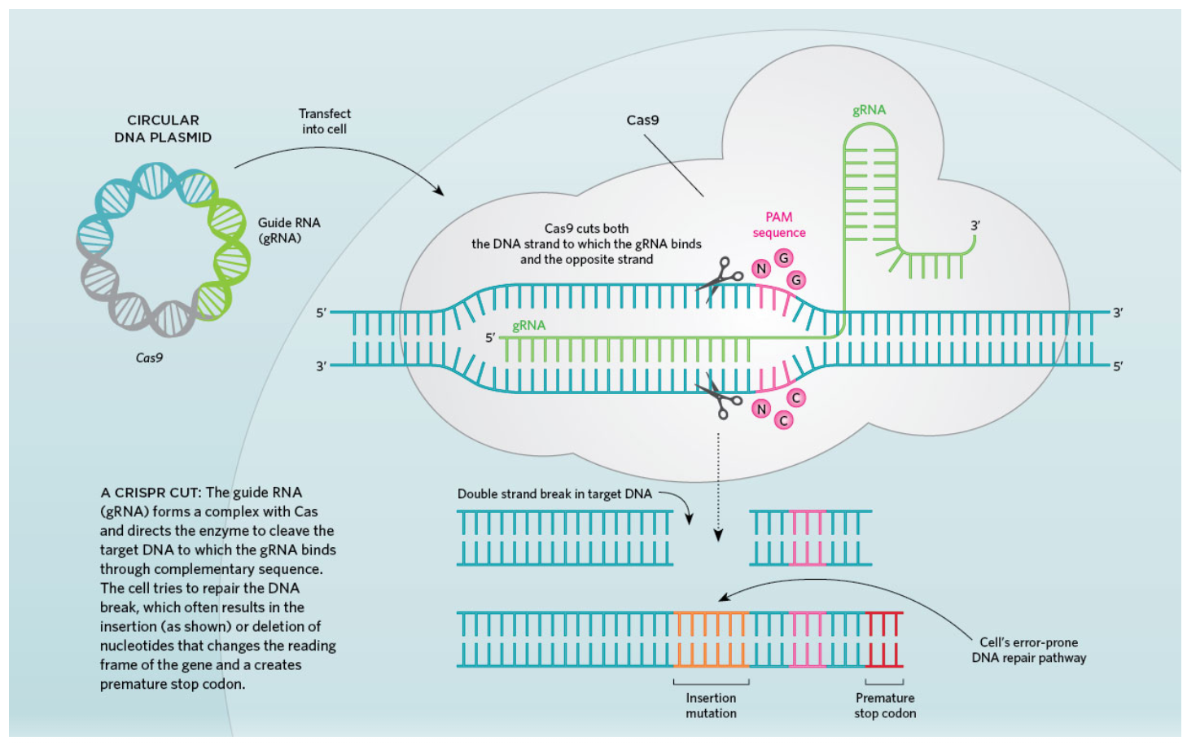
Introduction
What is genome editing?
Prospects: genetic disease
Risks: off-target effects
CRISPR ^{[1]}
Guide RNA and Cas9 enzyme
He Jiankui experiments ^{[2]}
[1] “Infographic: How CRISPR Works | The Scientist Magazine®.” https://www.the-scientist.com/infographics/how-crispr-works-68028 (accessed Nov. 16, 2021).
[2] D. Cyranoski, “The CRISPR-baby scandal: what’s next for human gene-editing,” Nature, vol. 566, no. 7745, pp. 440–442, Feb. 2019, doi: 10.1038/D41586-019-00673-1.

Slide 3
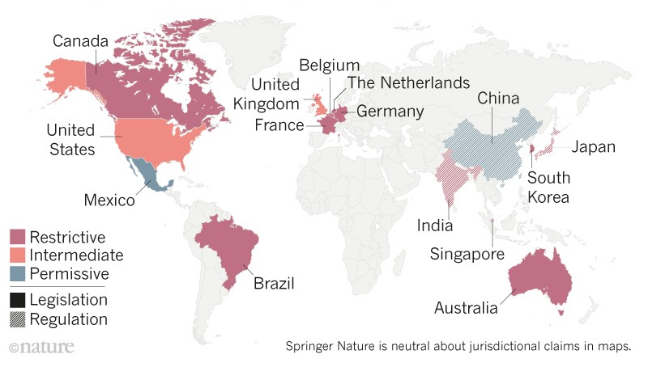
Position Overview
Side A
Supporters of embryo usage in gene editing research
Edit out heritable diseases
Recent studies showing limited off-target effects ^{[3]}
Few studies are able to be conducted ^{[4]}
[4] R. Isasi, E. Kleiderman, and B. M. Knoppers, “Editing policy to fit the genome? Framing genome editing policy requires setting thresholds of acceptability,” Science (80-. )., vol. 351, no. 6271, pp. 337–339, Jan. 2016, doi: 10.1126/SCIENCE.AAD6778/SUPPL_FILE/AAD6778_ISASI_SM.PDF.
[3] H. Ma et al., “Correction of a pathogenic gene mutation in human embryos,” Nat. 2017 5487668, vol. 548, no. 7668, pp. 413–419, Aug. 2017, doi: 10.1038/nature23305.

Slide 4
Position Overview
Side B
Opponents of embryo usage in gene editing research
Ramifications of usage on other research areas
Safety concerns of potentially viable embryos ^{[5]}
Created an international following
[5] M. V. Zuccaro et al., “Reading frame restoration at the EYS locus, and allele-specific chromosome removal after Cas9 cleavage in human embryos,” bioRxiv, p. 2020.06.17.149237, Jun. 2020, doi: 10.1101/2020.06.17.149237.

Slide 5
Conclusion
Current U.S. regulations
FDA & NIH trial requests
Optimal middle ground
Allow embryonic genome editing
Nonviable embryos used
Triponuclear zygotes ^{[6]}
Easier suspicious identification
[6] P. Liang et al., “CRISPR/Cas9-mediated gene editing in human tripronuclear zygotes,” Protein Cell, vol. 6, no. 5, pp. 363–372, May 2015, doi: 10.1007/S13238-015-0153-5/FIGURES/4.

Slide 6
Recommendation
FDA / NIH committee
Regulations controlled by spending bill
Provide guidance to government bodies
Composed of leading scientists
Oversee future trial requests
“Ecosystem” approach to regulation ^{[7]}
[7] R. A. Charo, “Rogues and Regulation of Germline Editing,” N. Engl. J. Med., vol. 380, no. 10, pp. 976–980, Mar. 2019, doi: 10.1056/NEJMMS1817528/SUPPL_FILE/NEJMMS1817528_DISCLOSURES.PD

